Slide 1
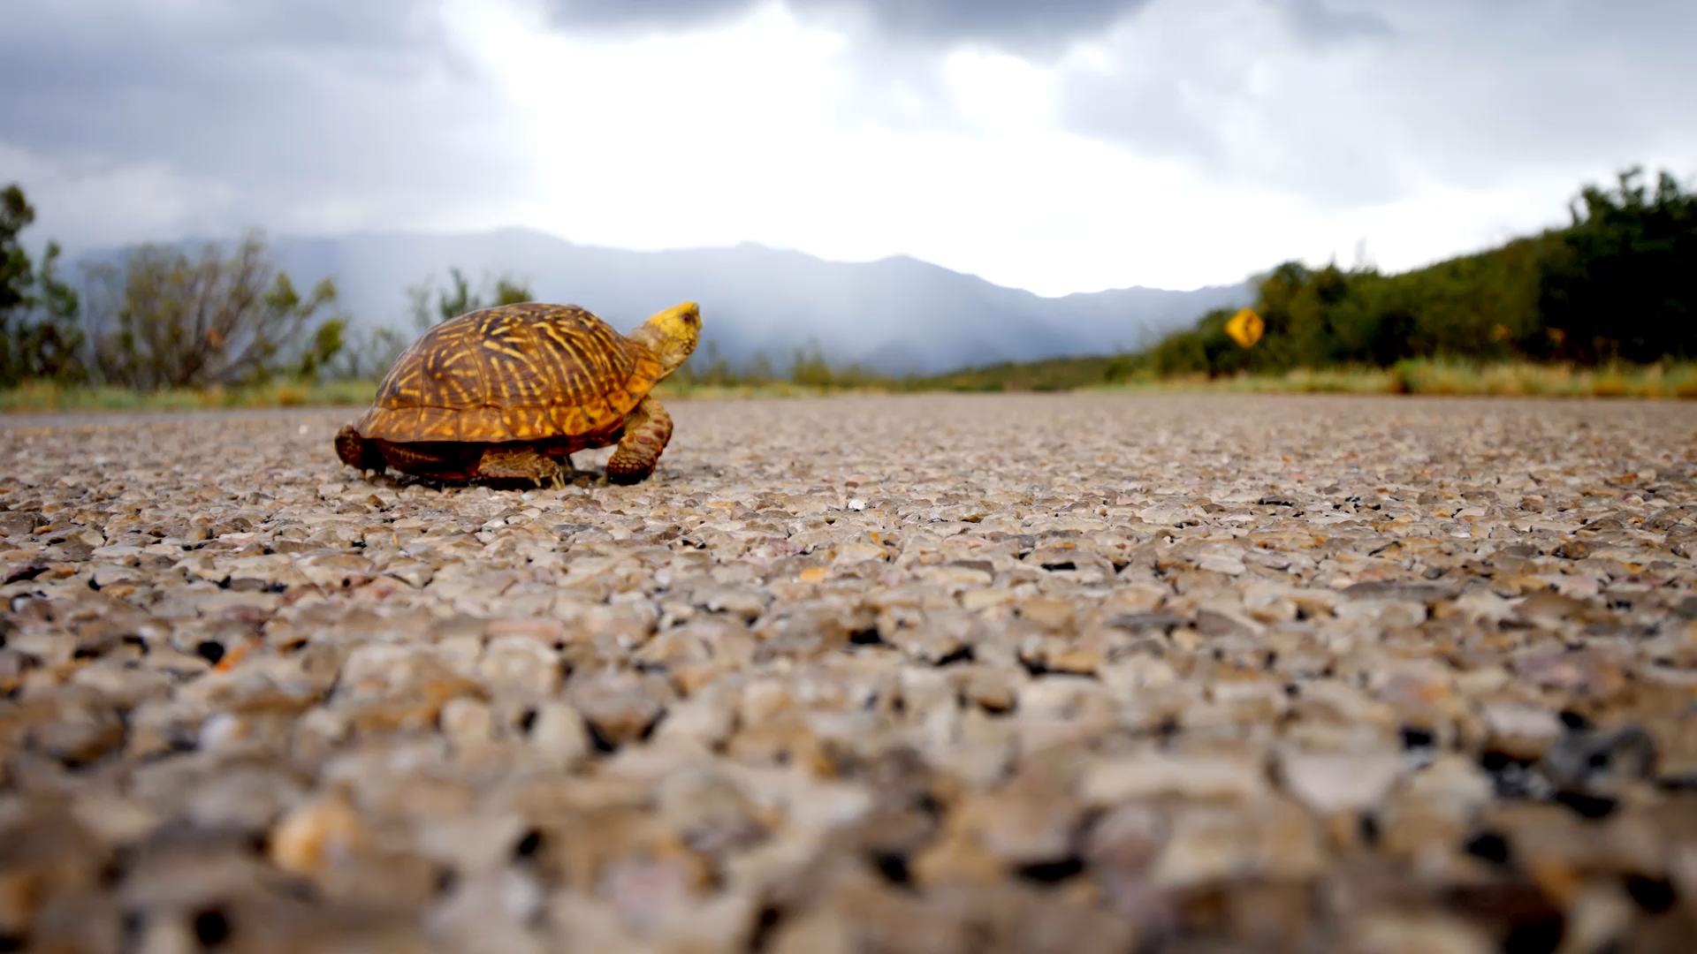
Turtle
Gus Lipkin

Slide 2
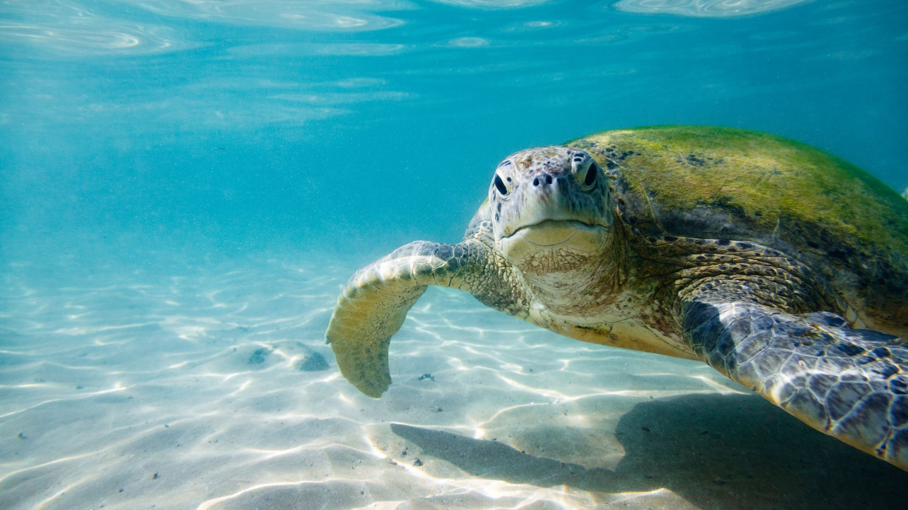
Turtle

Slide 3
Intermission

Slide 4
